Slide 1




Excel
Training
for Beginners
SAID FAWZY
Manager of Information Center
Tendering Department
Arab Contractors

Slide 2


Excel
Training
for Beginners
SAID FAWZY
3
MASTERING FORMULAS AND FUNCTIONS

Slide 3






90%
90%
1- Excel Formulas and Functions
2- Sum Function
3- COUNT and COUNTA Functions
4- AVEARAGE Function
5- MIN and MAX Functions

Slide 4
90%
90%
6- Handling Errors in Calculations
7- Absolute and Relative Referencing
8 - AutoSum and AutoFill
9 - Flash Fill
Exam 3: Functions Basics

Slide 5
Excel
Training
for Beginners
SAID FAWZY
Excel Formulas and Functions
1

Slide 6
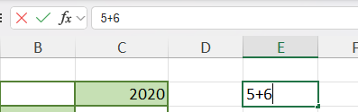
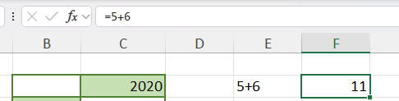
Excel Formulas and Functions
Write Formula Directly in a cell

Slide 7
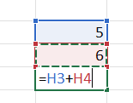
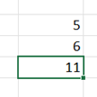
Excel Formulas and Functions
Write Formula Using Cell Referencing

Slide 8
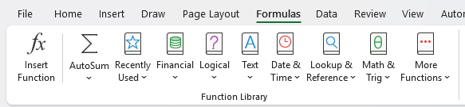
Excel Formulas and Functions
Functions

Slide 9
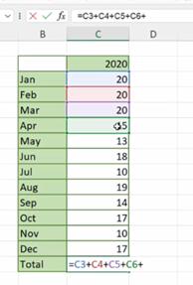
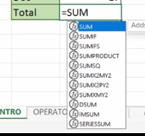

Excel Formulas and Functions
SUM Function

Slide 10
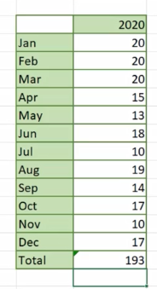
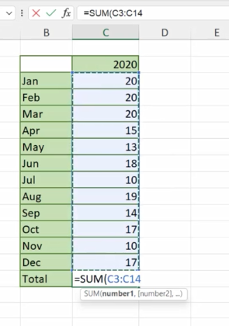
Excel Formulas and Functions
SUM Function

Slide 11
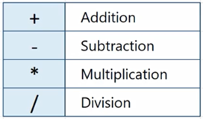
Excel Formulas and Functions
Math Operators

Slide 12
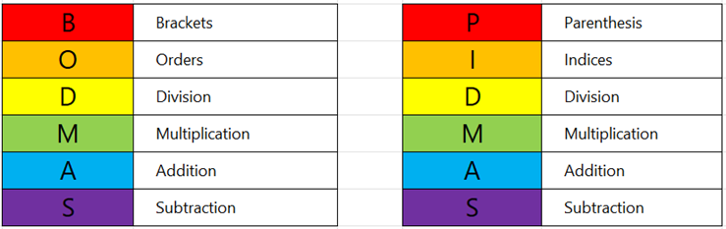
Excel Formulas and Functions
BODMAS Principle

Slide 13
Excel
Training
for Beginners
SAID FAWZY
2
Sum Function

Slide 14
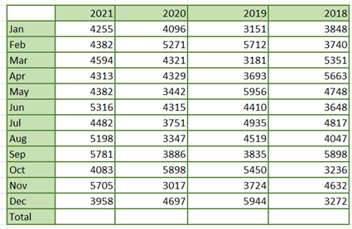
Sum Function
SUM Function

Slide 15
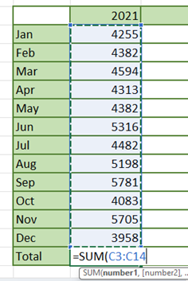
Sum Function
SUM Function

Slide 16

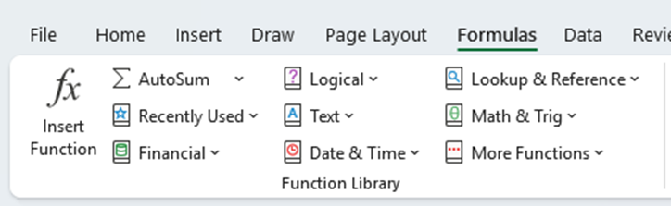
Sum Function
Formula Dialogue Box

Slide 17
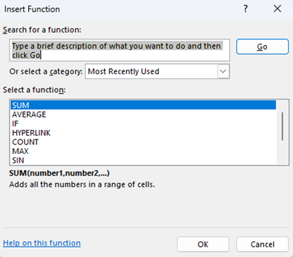
Sum Function
Formula Dialogue Box

Slide 18
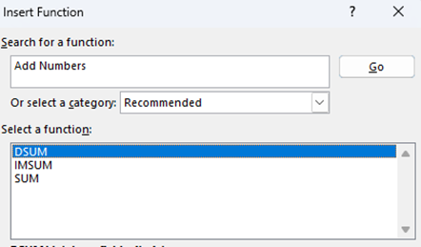
Sum Function
Formula Dialogue Box

Slide 19
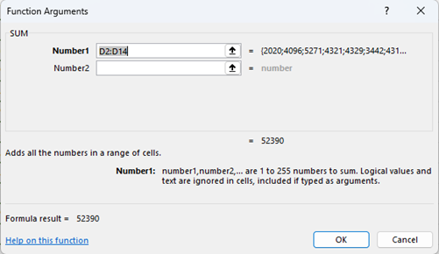
Sum Function
Formula Dialogue Box

Slide 20
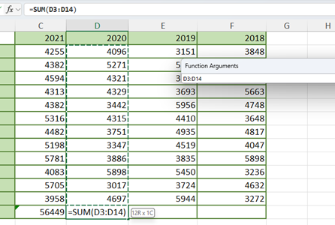
Sum Function
Formula Dialogue Box

Slide 21
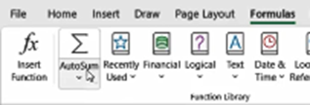
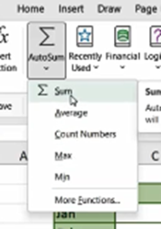
Sum Function
AutoSum Button

Slide 22
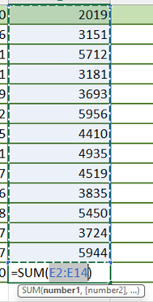

Sum Function
AutoSum Button

Slide 23
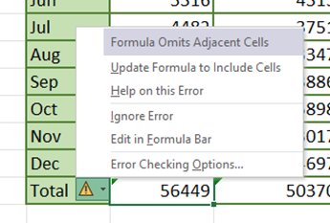
Sum Function
Warning Massage

Slide 24
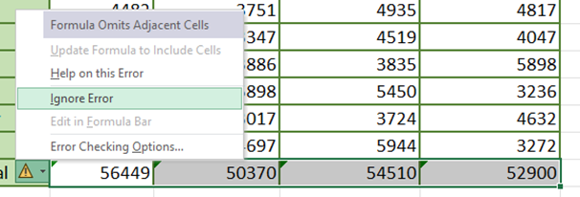
Sum Function
Warning Massage

Slide 25
Excel
Training
for Beginners
SAID FAWZY
COUNT and COUNTA Functions
3

Slide 26
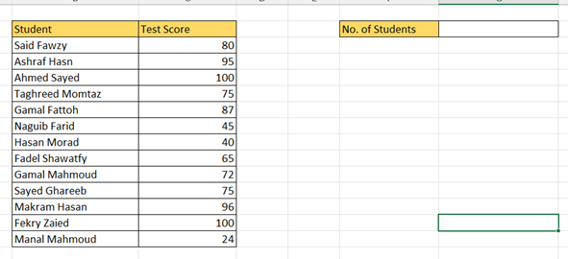
COUNT and COUNTA Functions
COUNT Function

Slide 27
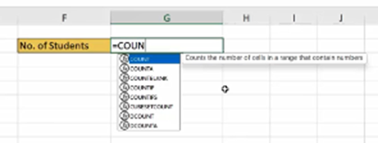

COUNT and COUNTA Functions
COUNT Function

Slide 28

COUNT and COUNTA Functions
COUNTA Function

Slide 29
COUNT and COUNTA Functions
COUNTBLANK Function

Slide 30
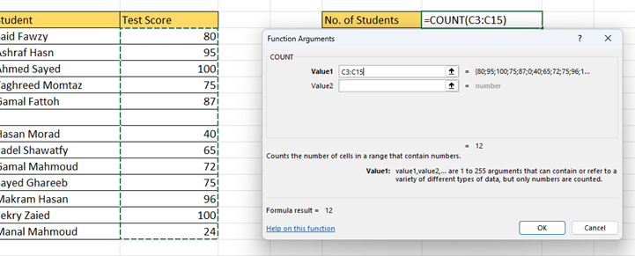
COUNT and COUNTA Functions
Insert Function Dialogue Box

Slide 31
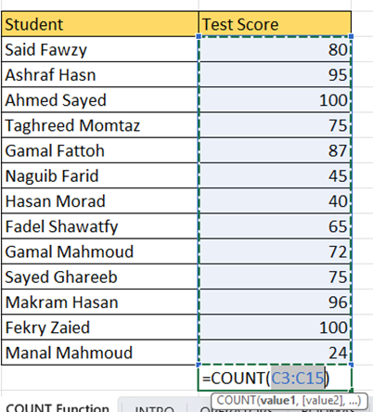
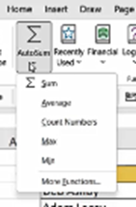
COUNT and COUNTA Functions
Using AutoSum Button

Slide 32
Excel
Training
for Beginners
SAID FAWZY
4
AVEARAGE Function

Slide 33
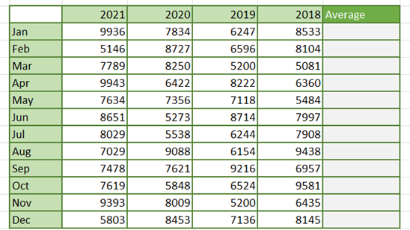
AVEARAGE Function
AVERAGE Function

Slide 34
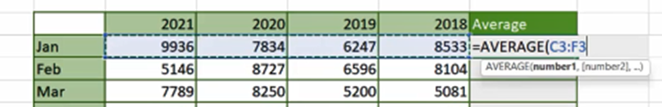
AVEARAGE Function
AVERAGE Function

Slide 35

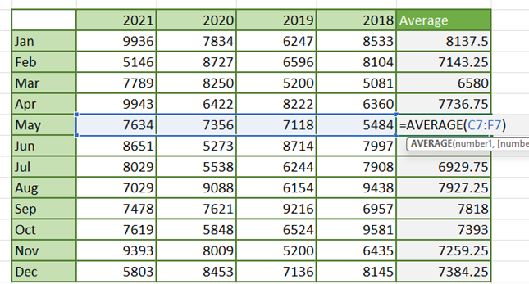
AVEARAGE Function
AutoFill Formula

Slide 36
AVEARAGE Function
Relative Referencing

Slide 37
Excel
Training
for Beginners
SAID FAWZY
MIN and MAX Functions
5

Slide 38
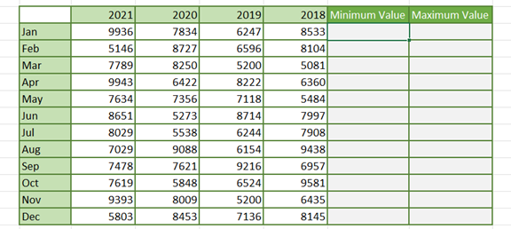
MIN and MAX Functions
MIN and MAX Functions

Slide 39

MIN and MAX Functions
MIN and MAX Functions

Slide 40

MIN and MAX Functions
MIN and MAX Functions

Slide 41
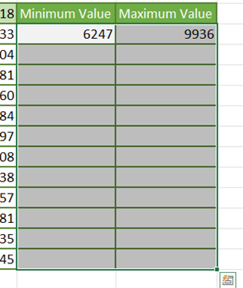
MIN and MAX Functions
Copy Formula Down Using Shortcut

Slide 42
MIN and MAX Functions
Copy Formula Down Using Shortcut

Slide 43
Excel
Training
for Beginners
SAID FAWZY
Handling Errors in Calculations
6

Slide 44
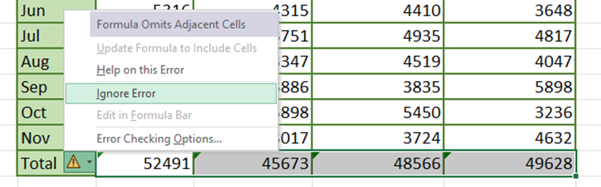
Handling Errors in Calculations
Warnings

Slide 45
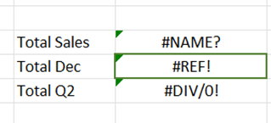
Handling Errors in Calculations
Types of Errors

Slide 46

Handling Errors in Calculations
#NAME Error

Slide 47
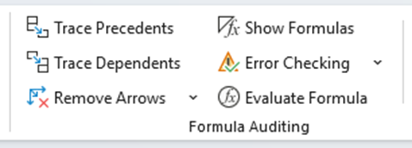
Handling Errors in Calculations
Formula Auditing

Slide 48
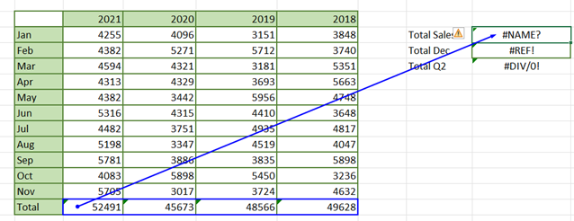
Handling Errors in Calculations
Trace Precedents

Slide 49
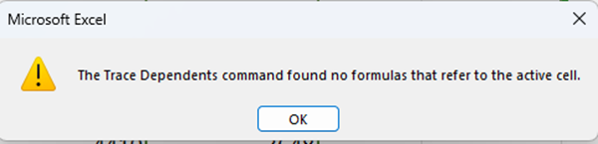
Handling Errors in Calculations
Trace Dependence

Slide 50
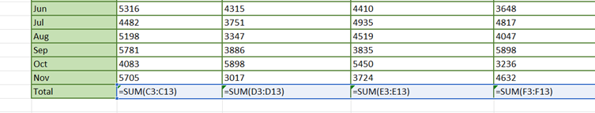
Handling Errors in Calculations
Show Formula

Slide 51
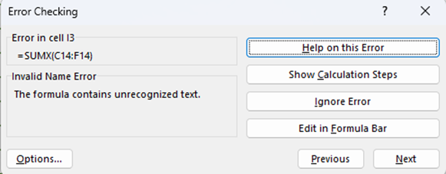
Handling Errors in Calculations
Error Checking

Slide 52
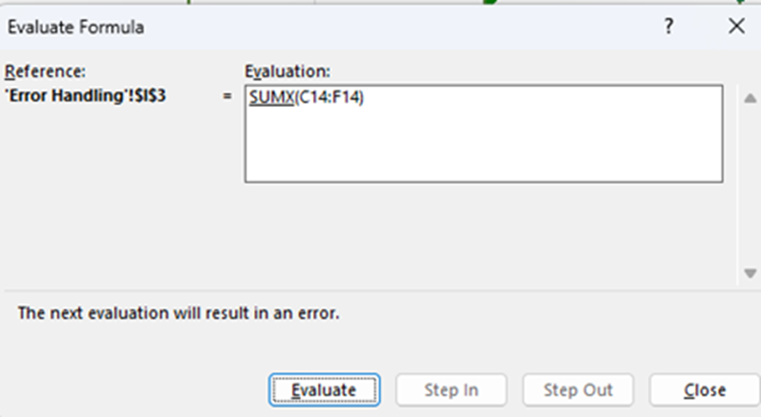
Handling Errors in Calculations
Error Checking
- Show Calculation Steps

Slide 53

Handling Errors in Calculations
Error Checking
- Show Calculation Steps

Slide 54

Handling Errors in Calculations
#REF! Error

Slide 55
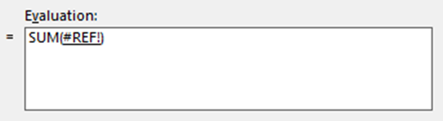

Handling Errors in Calculations
#REF! Error
Evaluate Formula

Slide 56
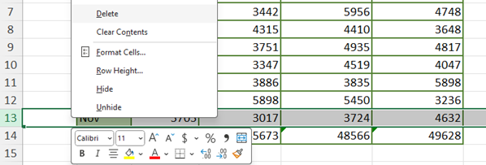
Handling Errors in Calculations
#REF! Error

Slide 57


Handling Errors in Calculations
#DIV/0

Slide 58
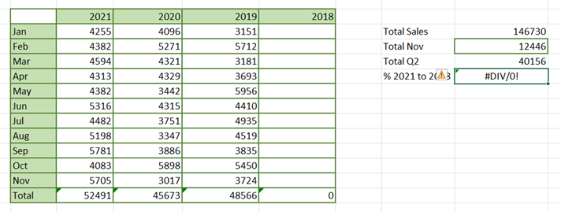
Handling Errors in Calculations
#DIV/0

Slide 59
Excel
Training
for Beginners
SAID FAWZY
Absolute and Relative Referencing
7

Slide 60
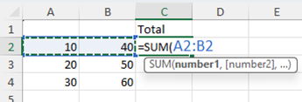
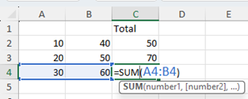
Absolute and Relative Referencing
Relative Referencing

Slide 61
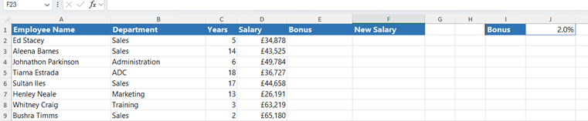
Absolute and Relative Referencing
Absolute Reference

Slide 62
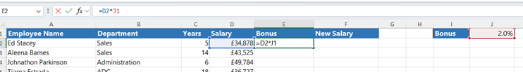
Absolute and Relative Referencing
Absolute Reference

Slide 63
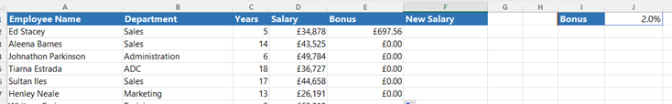
Absolute and Relative Referencing
Absolute Reference

Slide 64
Absolute and Relative Referencing
Absolute Reference

Slide 65
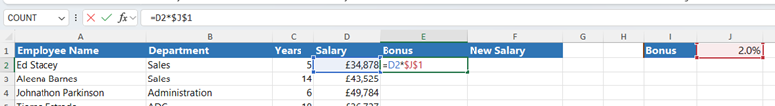
Absolute and Relative Referencing
Absolute Reference
Lock Cell $J$1

Slide 66

Absolute and Relative Referencing
Absolute Reference
Lock Cell $J$1

Slide 67
Excel
Training
for Beginners
SAID FAWZY
8
AutoSum and AutoFill

Slide 68

AutoSum and AutoFill
AutoSum and AutoFill

Slide 69
AutoSum and AutoFill
AutoSum and AutoFill
AutoFill (4 Methods)
1. Double-click
2. Drag down
3. Fill Down button
4. Keyboard Shortcut

Slide 70

AutoSum and AutoFill
Years Totals

Slide 71



AutoSum and AutoFill
Months Totals

Slide 72

AutoSum and AutoFill
Create Fill down Numbers

Slide 73


AutoSum and AutoFill
Create Fill down Numbers

Slide 74

AutoSum and AutoFill
Create Fill down Numbers

Slide 75

AutoSum and AutoFill
Fill down Dates

Slide 76


AutoSum and AutoFill
Fill down Dates

Slide 77

AutoSum and AutoFill
Months and Days

Slide 78

AutoSum and AutoFill
Custom Lists

Slide 79
Excel
Training
for Beginners
SAID FAWZY
9
Flash Fill

Slide 80

Flash Fill
Invoke “Flash Fill”.

Slide 81

Flash Fill
Invoke “Flash Fill”.

Slide 82

Flash Fill
Invoke “Flash Fill”.

Slide 83

Flash Fill
Invoke “Flash Fill”.

Slide 84

Flash Fill
Invoke “Flash Fill”.

Slide 85

Flash Fill
Invoke “Flash Fill”.

Slide 86

Flash Fill
Invoke “Flash Fill”.

Slide 87
Excel
Training
for Beginners
SAID FAWZY
Exam 3
Functions Basics

Slide 88

Exam 3: Functions Basics

Slide 89

Exam 3: Functions Basics

Slide 90

Exam 3: Functions Basics

Slide 91

Exam 3: Functions Basics

Slide 92



